Slide 1

Unit 6 - Development of Surfaces Examples
Engineering Graphics (MEC103)

Slide 2
PARALLEL LINE METHOD

Slide 3
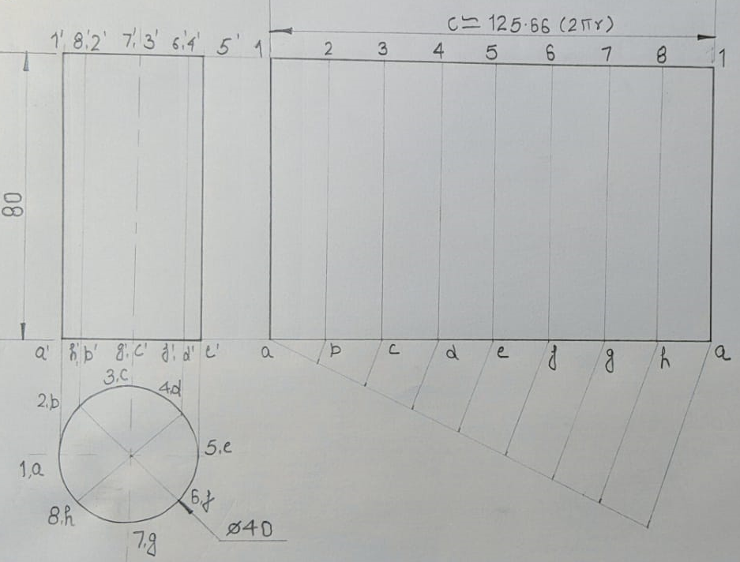
Development of Cylinder

Slide 4
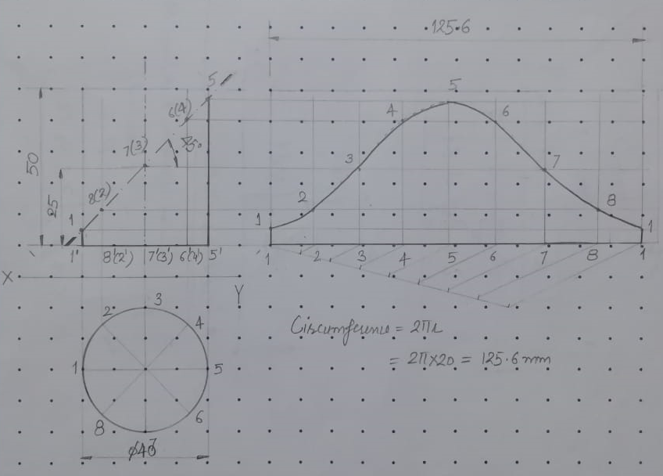
Development of Truncated Cylinder

Slide 5
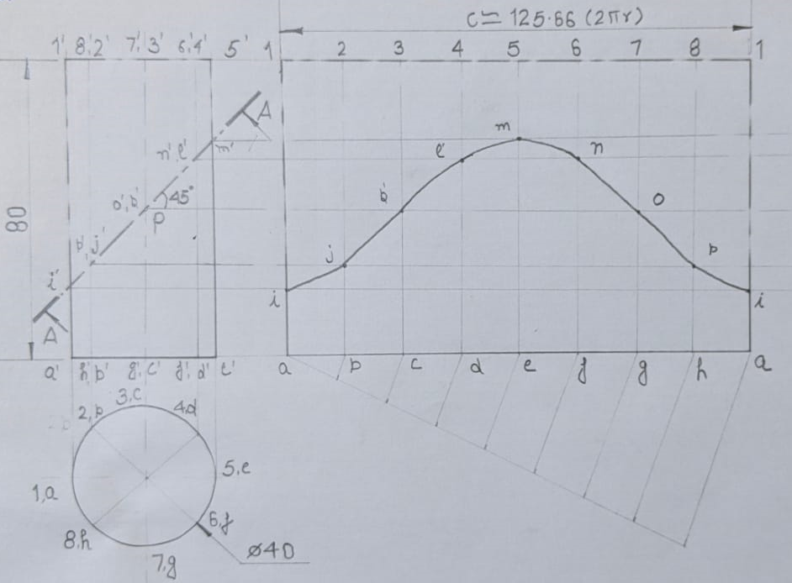
Development of Truncated Cylinder

Slide 6
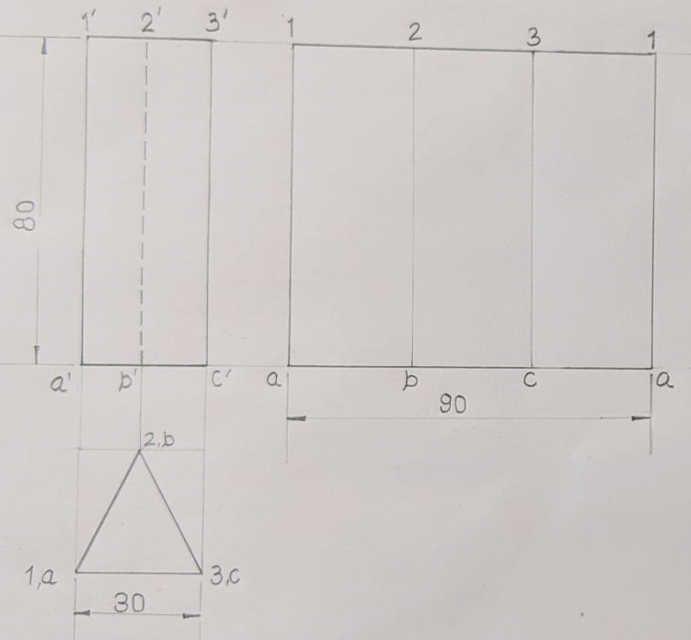
Development of Triangular Prism

Slide 7
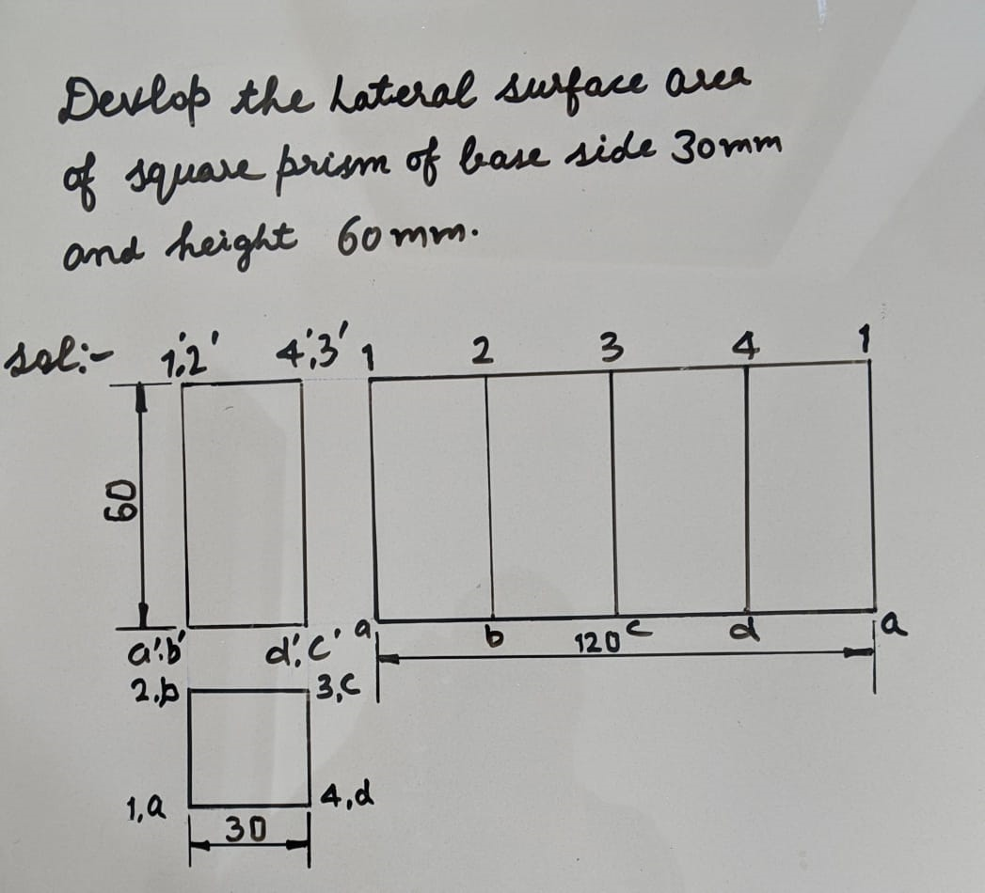
Development of Square Prism

Slide 8
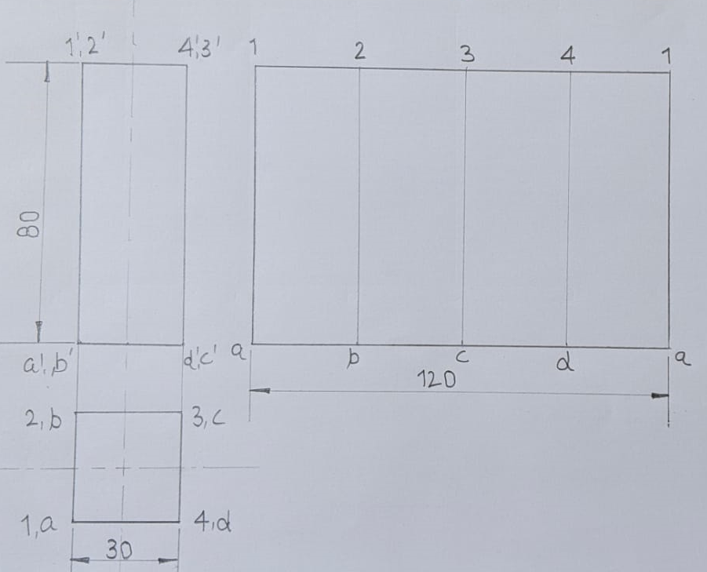
Development of Square Prism

Slide 9
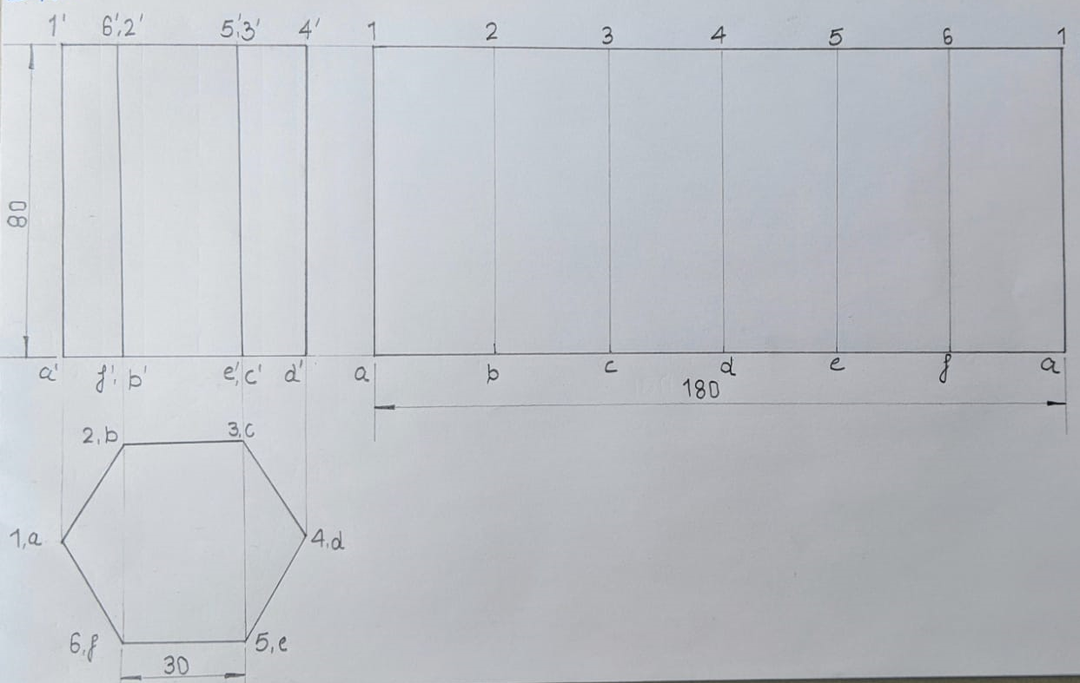
Development of Hexagonal Prism

Slide 10
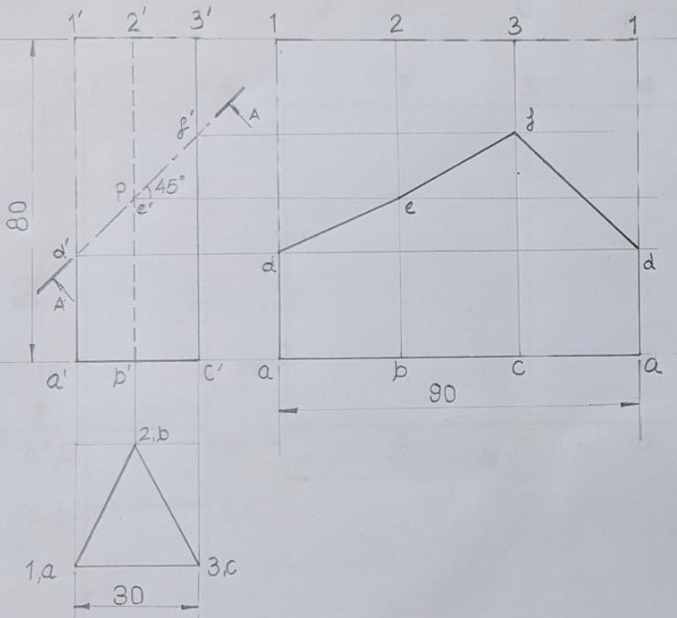
Development of Truncated Triangular Prism

Slide 11
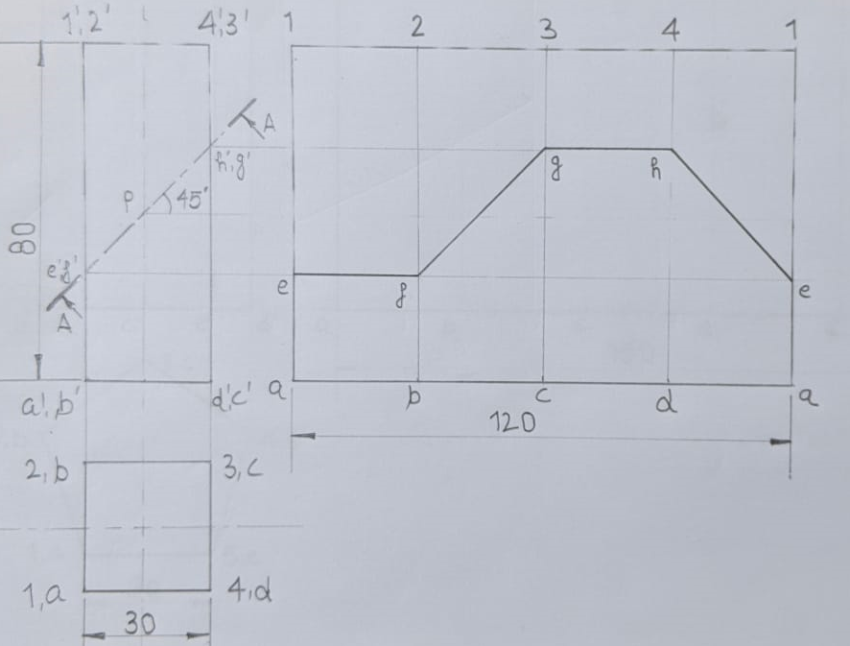
Development of Truncated Square Prism

Slide 12
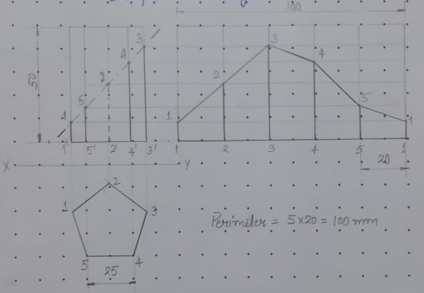
Development of Truncated Pentagonal Prism

Slide 13
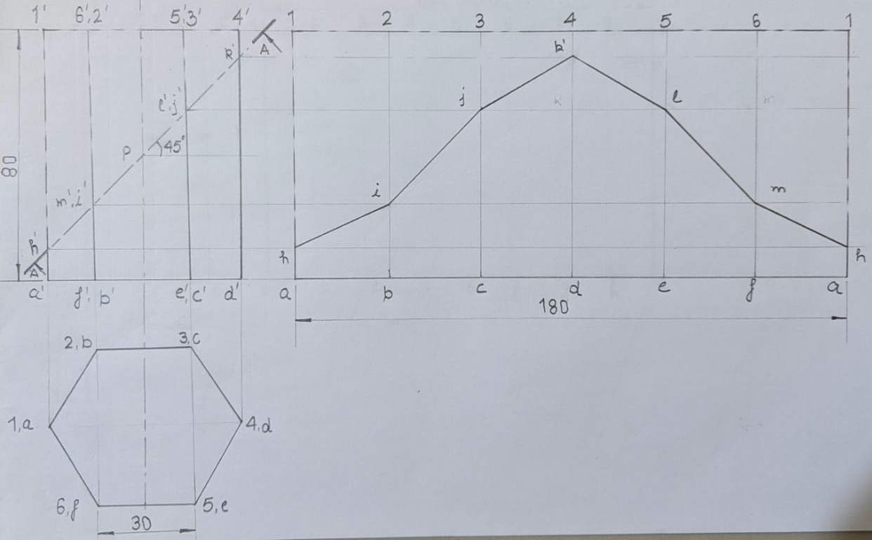
Development of Truncated Hexagonal Prism

Slide 14
RADIAL LINE METHOD

Slide 15
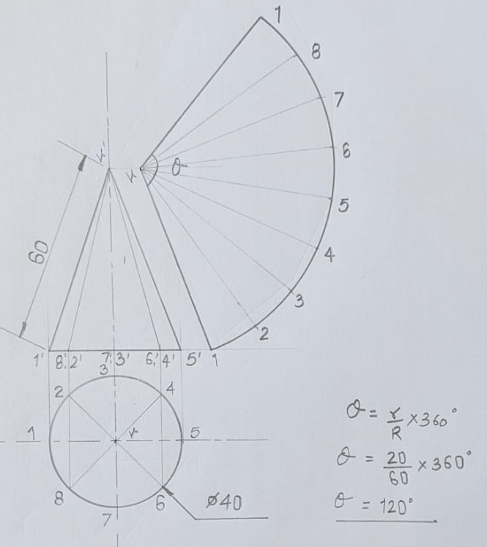
Development of Cone

Slide 16
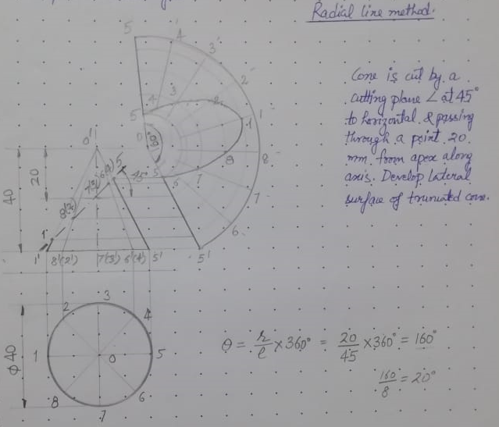
Development of Truncated Cone

Slide 17
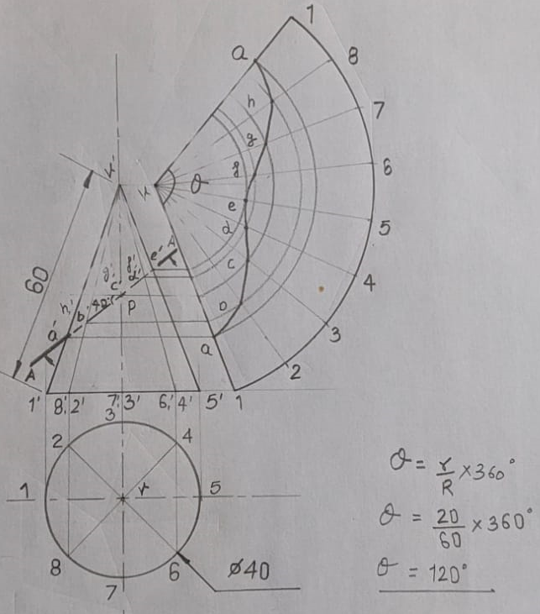
Development of Truncated Cone

Slide 18
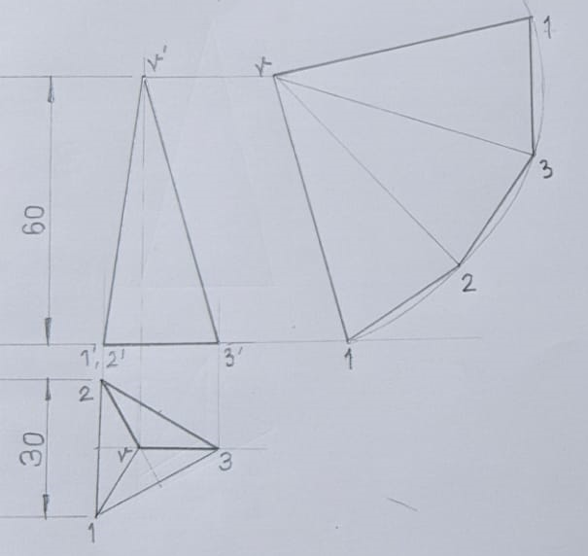
Development of Triangular Pyramid

Slide 19
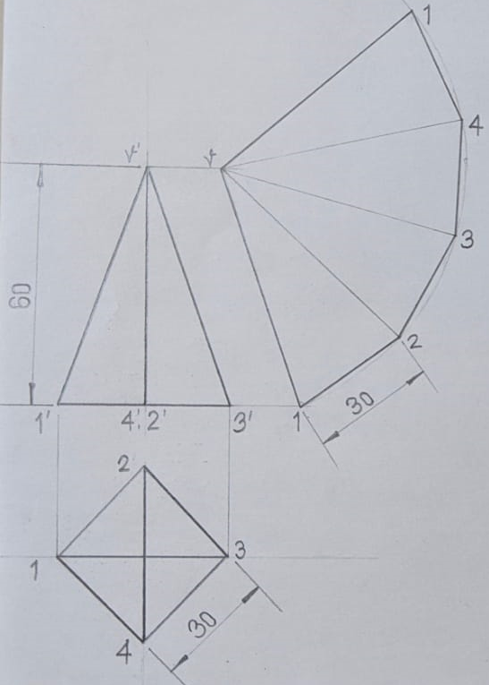
Development of Square Pyramid

Slide 20
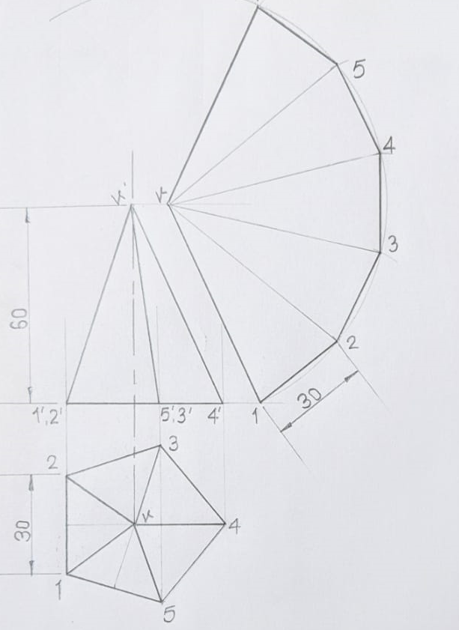
Development of Pentagonal Pyramid

Slide 21
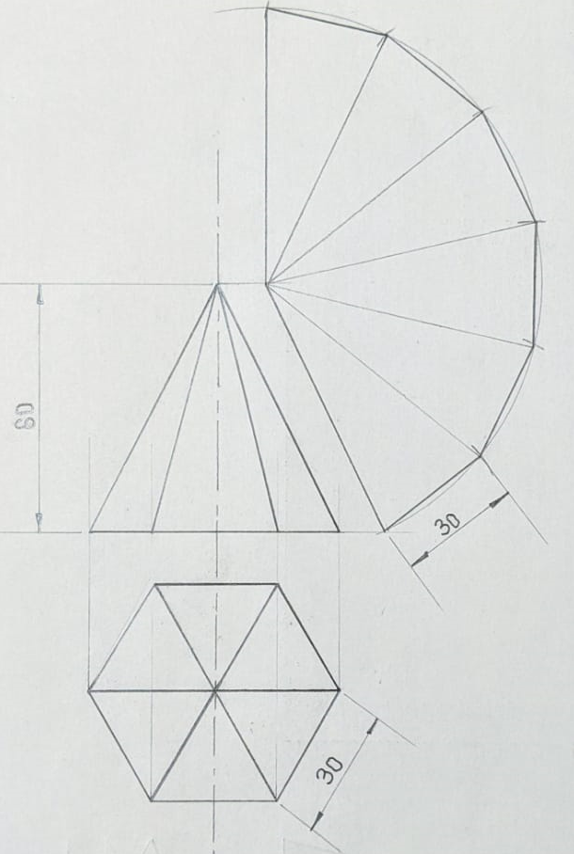
Development of Hexagonal Pyramid

Slide 22
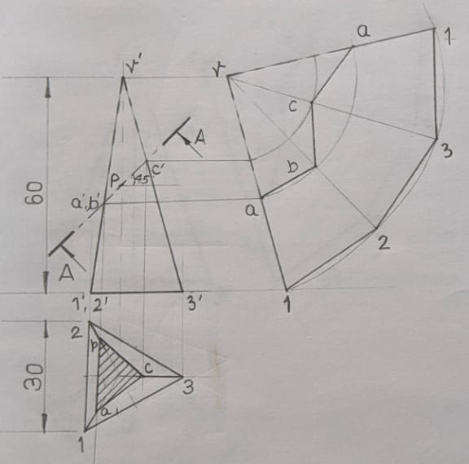
Development of Truncated Triangular Pyramid

Slide 23
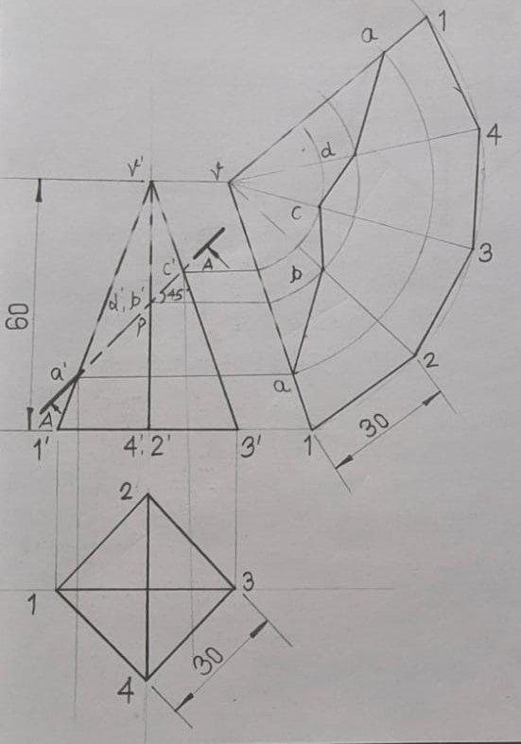
Development of Truncated Square Pyramid

Slide 24
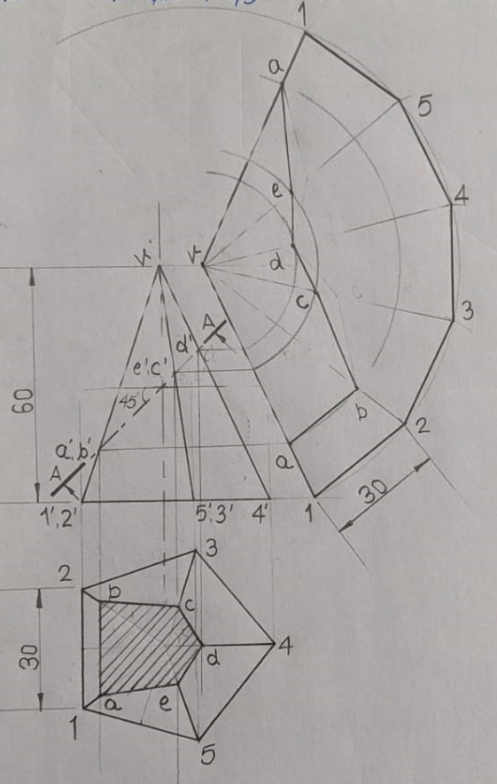
Development of Truncated Pentagonal Pyramid

Slide 25
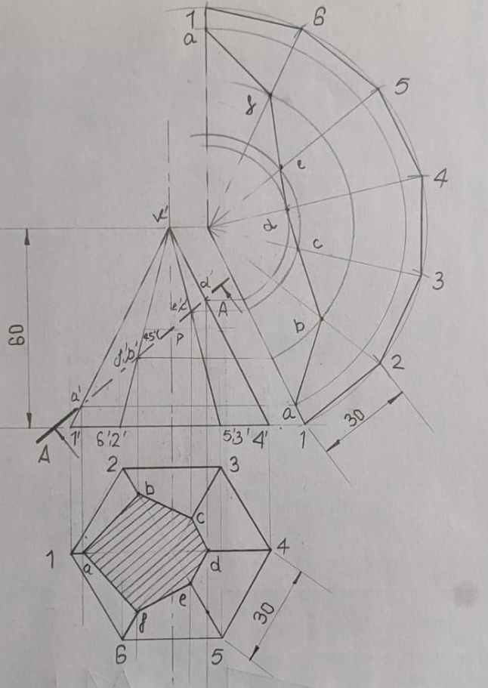
Development of Truncated Hexagonal Pyramid

Slide 26
THANKS

